Slide 1
PEOPLE: DIFFICULT… OR DIFFERENT?

Slide 2
TRUST AND RESPECT
People
People
Tasks
Tasks
People
People
Tasks
Tasks

Slide 3
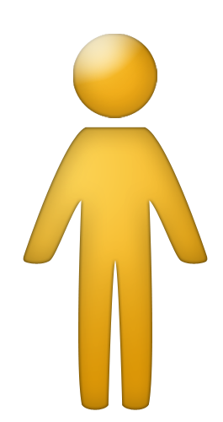
Perceptions
Perceptions
(Values)
(Values)
Beliefs
Beliefs
Behavior
Behavior

Slide 4
ICEBERG
Choice
Observable Behavior
Total Personality

Slide 5
BEHAVIOR VS. PERSONALITY
PERSONALITY is who you are.
BEHAVIOR is what you do.
PERSONALITY cannot be situationally, intentionally and temporarily modified by choice.
BEHAVIOR can be situationally, intentionally and temporarily modified by choice.

Slide 6
Patterns of Behavior
Choice
Observable Behavior
Personality
Environment
Situation

Slide 7
KEY POINTS
There are various, common patterns of behavior (i.e., Behavior Patterns).
Behavior Patterns do not define an individual – they describe the behavior they are showing.
People change their behavior depending on the situation and environment they are in.
Being able to identify the Behavior Patterns of others and respond in a way that makes a positive impact helps build trust and respect.

Slide 8
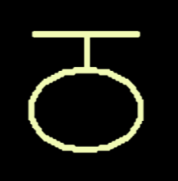
WHAT’S THE PATTERN?
?
If you can identify the pattern you can make sense of it and know what comes next

Slide 9
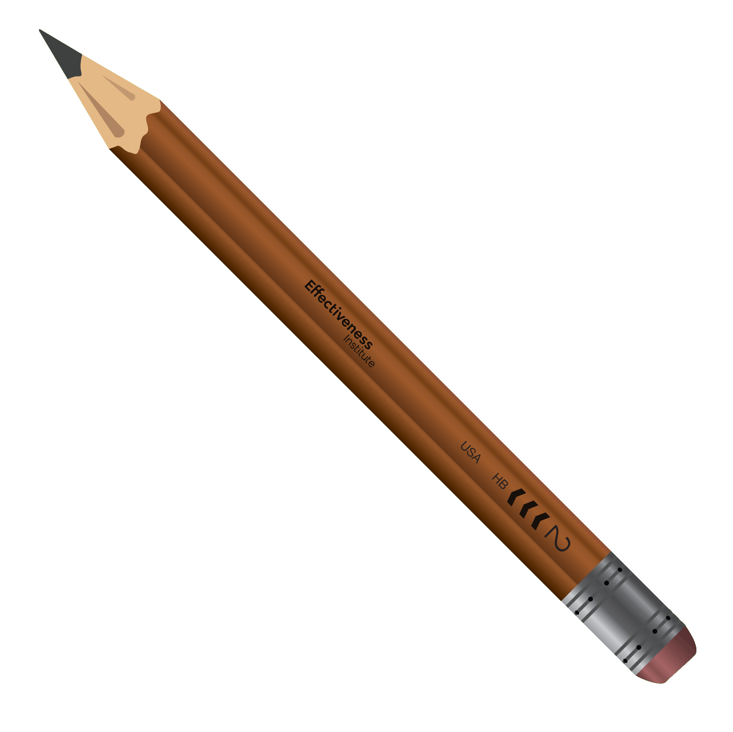
FOUR LINES OF BEHAVIOR

Slide 10
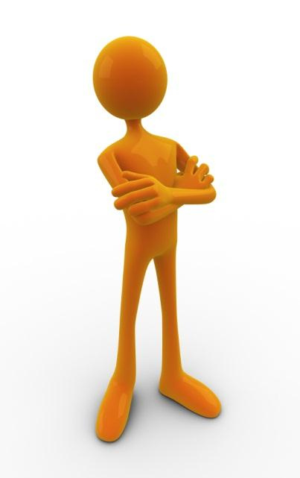
Think of a specific person that is difficult or challenging for you to work with…

Slide 11
DECISIONS

Slide 12
DECISIONS
Fast, Gut

Slide 13
DECISIONS
Process

Slide 14
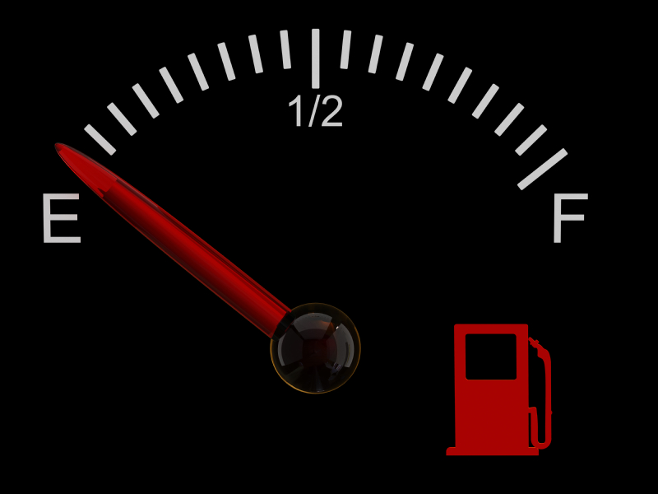
DECISIONS
Process
Fast, Gut
Trust and Respect
Slow
Clinical
Indecisive
Bossy
Pushy
Rude

Slide 15
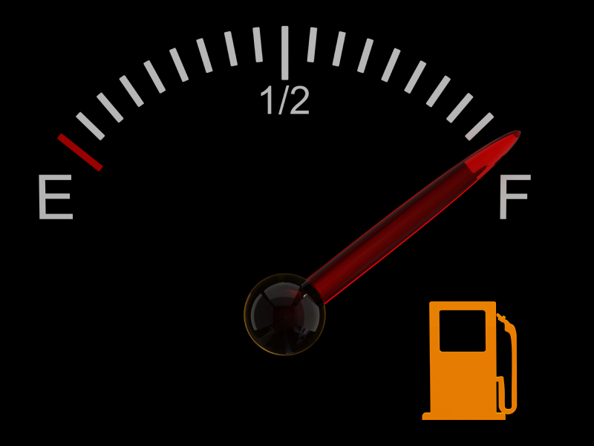
DECISIONS
Process
Fast, Gut
Trust and Respect
Thoughtful
Comprehensive
Thorough
Decisive
Courageous
Fearless

Slide 16
DECISIONS
Process
Fast, Gut

Slide 17
DECISIONS
Process
Fast, Gut

Slide 18
ENVIRONMENT

Slide 19
ENVIRONMENT
Stable

Slide 20
ENVIRONMENT
Dynamic

Slide 21
ENVIRONMENT
Dynamic
Trust and Respect
Stable
Impulsive
Unfocused
Random
Timid
Uncreative
Boring

Slide 22
ENVIRONMENT
Dynamic
Trust and Respect
Stable
Creative
Flexible
Energetic
Dependable
Consistent
Harmonious

Slide 23
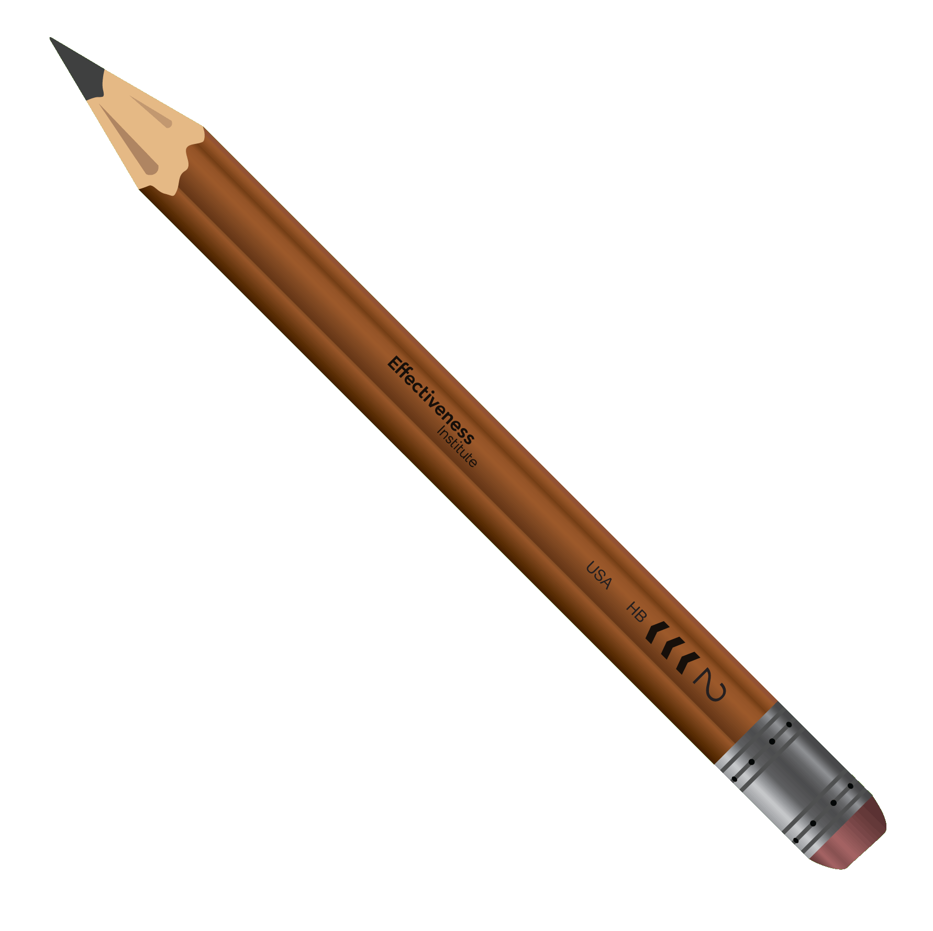
ENVIRONMENT
Dynamic
Stable

Slide 24
ENVIRONMENT
Dynamic
Stable

Slide 25
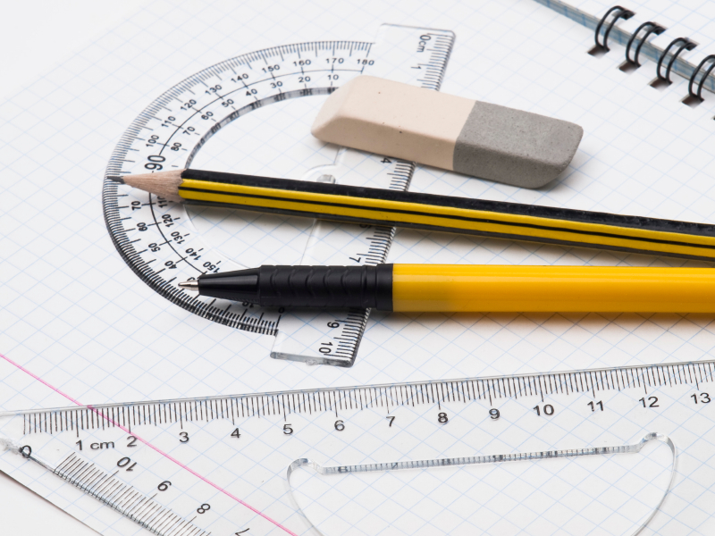
ACCURACY

Slide 26
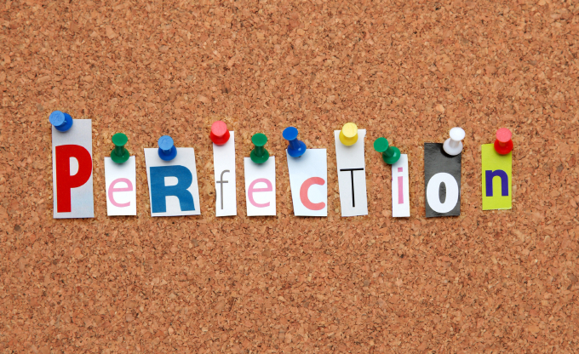
ACCURACY
Right Way

Slide 27
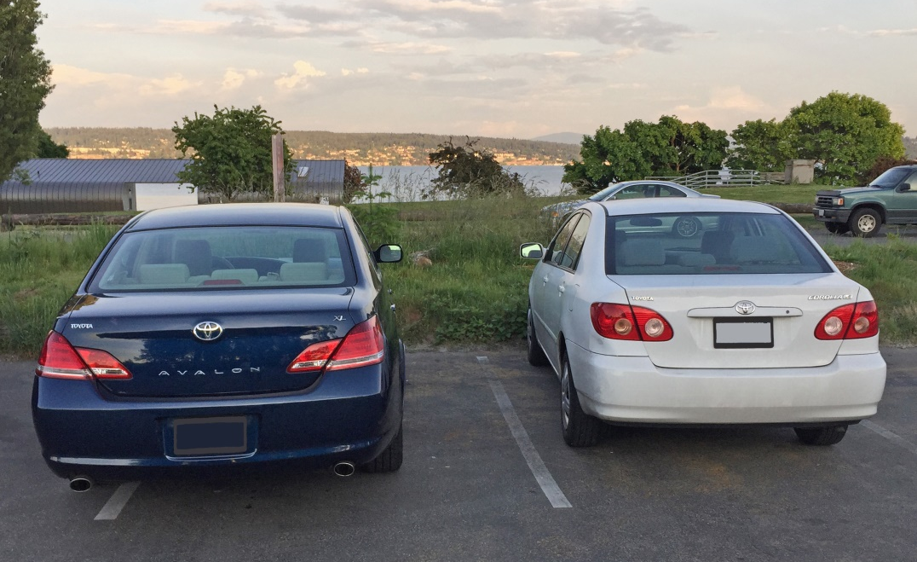
ACCURACY
Get it
Done

Slide 28
ACCURACY
Get it
Done
Trust and Respect
Right Way
Careless
Sloppy
Reckless
Rigid
Uptight
Obsessive

Slide 29
ACCURACY
Get it
Done
Trust and Respect
Right Way
Big Picture
Shrewd
Ingenious
Precise
Defined
Truthful

Slide 30
ACCURACY
Get it
Done
Right Way

Slide 31
ACCURACY
Get it
Done
Right Way

Slide 32
PEOPLE

Slide 33
PEOPLE
Socially
Assertive

Slide 34
PEOPLE
Socially
Cautious

Slide 35
PEOPLE
Trust and Respect
Insecure
Fearful
Stuck-up
Dramatic
Shallow
Egotistical
Socially
Cautious
Socially
Assertive

Slide 36
PEOPLE
Trust and Respect
Restrained
Humble
Reserved
Confident
Self-assured
Outgoing
Socially
Cautious
Socially
Assertive

Slide 37
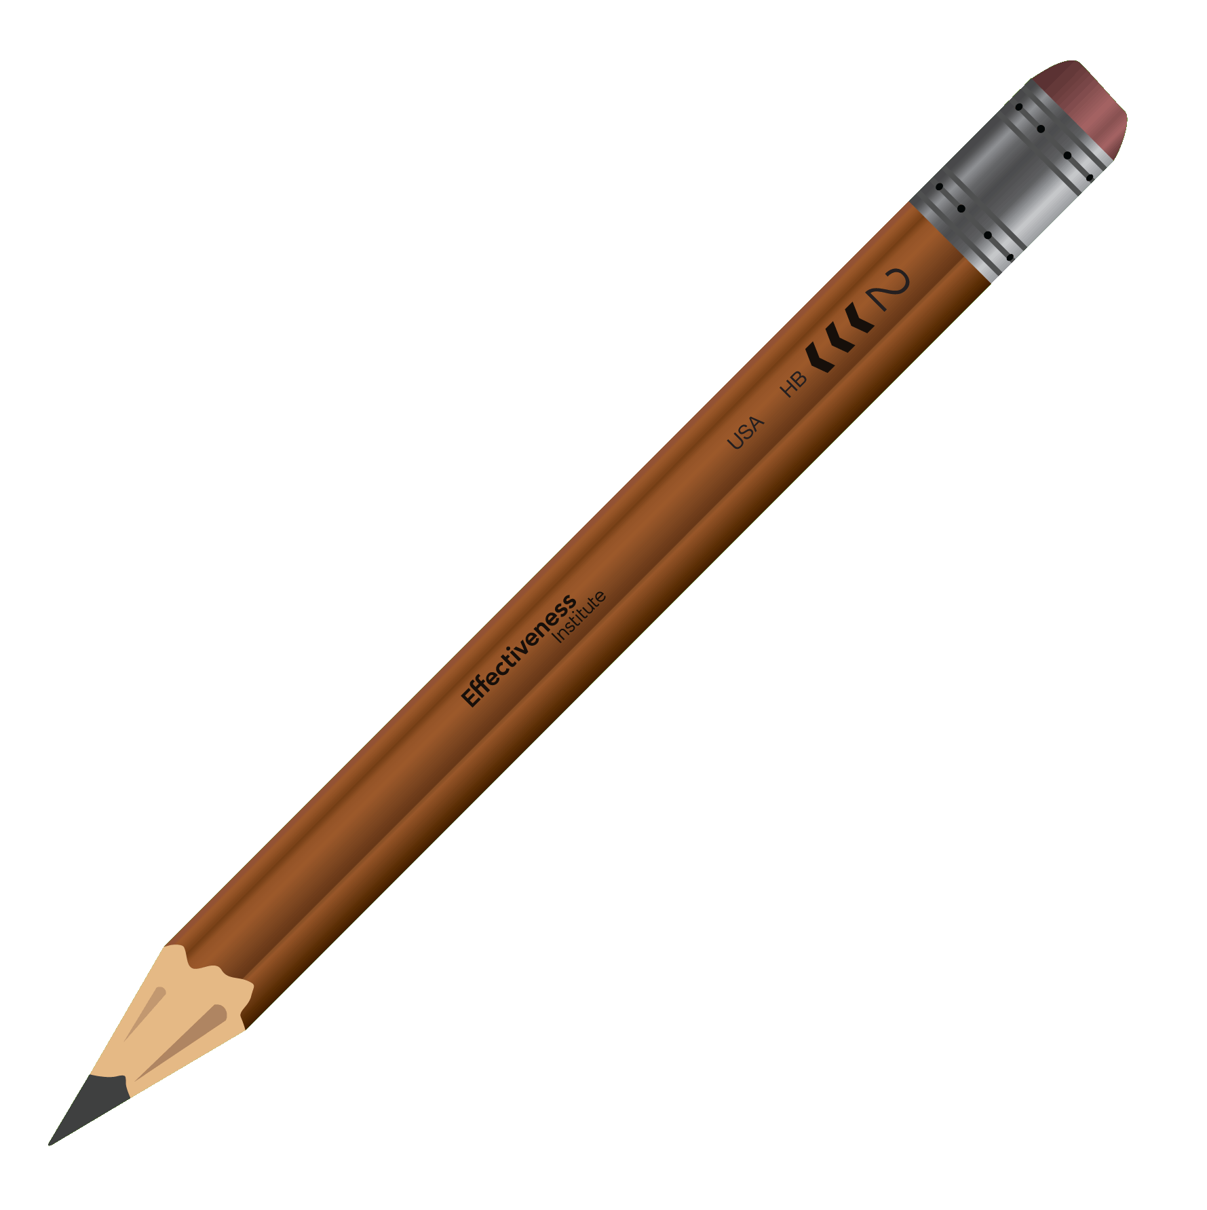
PEOPLE
Socially
Cautious
Socially
Assertive

Slide 38
PEOPLE
Socially
Cautious
Socially
Assertive

Slide 39
PATTERN 1
PATTERN 2
PATTERN 1 and 2
Decisions
Environment
Accuracy
People

Slide 40
PATTERN 3
Decisions
Environment
Accuracy
People

Slide 41
PATTERN 4 - LEARNED BALANCE
Decisions
Environment
Accuracy
People

Slide 42
PATTERN 5 - SITUATIONALLY APPROPRIATE
Decisions
Environment
Accuracy
People

Slide 43
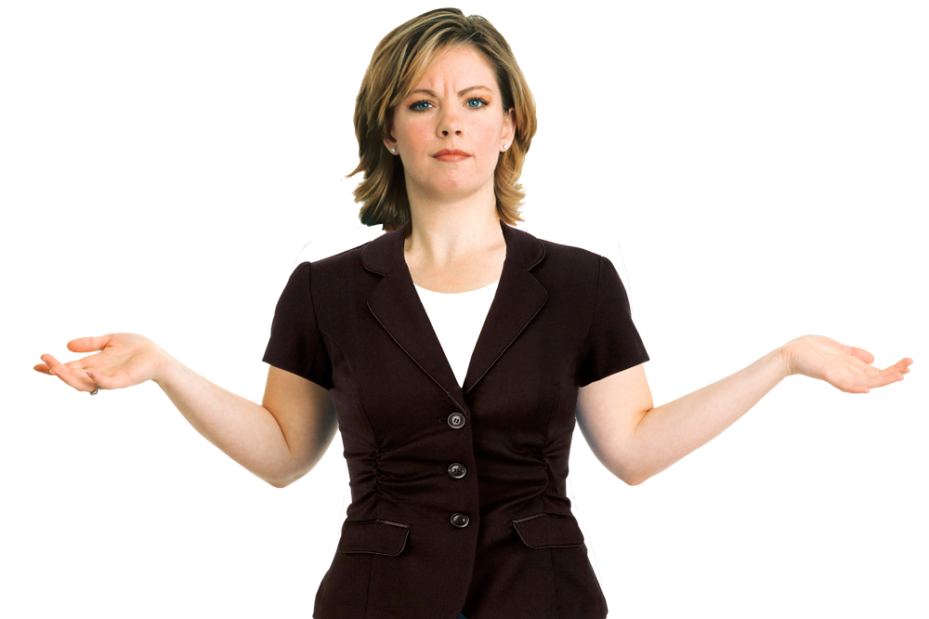
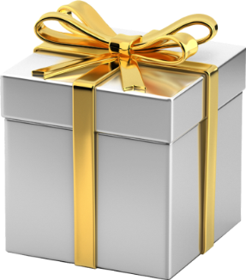
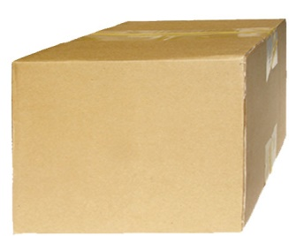
INTENT AND IMPACT
INTENT
IMPACT
Our behavior makes an IMPACT.
When our IMPACT is positive, trust and respect increase.
When our IMPACT is negative, trust and respect decrease.
TOXIC

Slide 44
TWO KEY POINTS
We need to know our IMPACT.
People guess our INTENT based upon our IMPACT so…
Even if our INTENT is positive our IMPACT can be negative.
We can choose behaviors that create positive IMPACT.

Slide 45
FROM FOUR TO TWO LINES
To make behavior pattern information easier to remember and apply, we convert the four lines to two lines.
This creates a four quadrant model that identifies an individual’s behavior pattern.
We call these four different patterns Behavior Styles.

Slide 46
RESULTS How do you tend to go about getting things done?
PROCESS
RESULTS
EXPEDIENCE
Process focused individuals tend to take a more systematic approach to their work and are concerned with how the work is done.
Expedience focused individuals tend to take a “big-picture” approach to their work and are concerned with how quickly work is done.

Slide 47
EMOTIONS How do you tend to interact with others?
CONTROLLED
Controlled individuals tend to limit the amount of emotion they show and focus energy on what the work is.
EMOTIONS
Responsive individuals tend to easily express their emotions and focus energy on the people involved in and doing the work.
RESPONSIVE

Slide 48
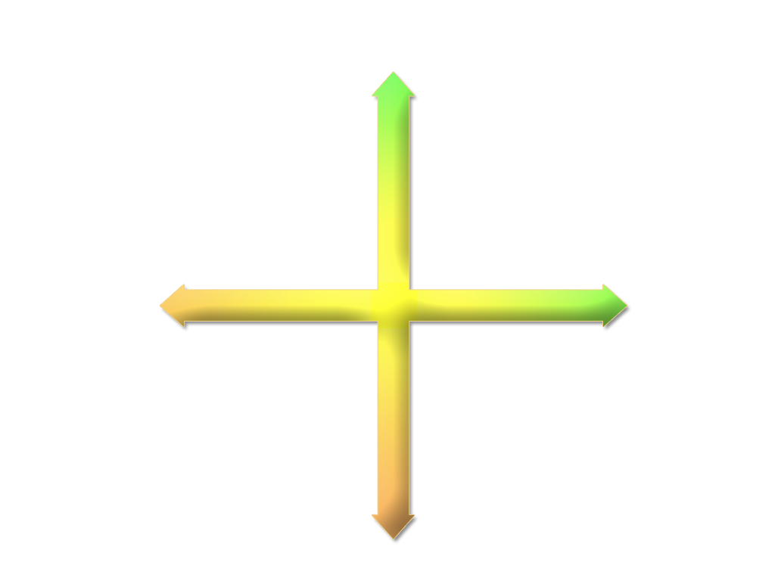
BEHAVIOR STYLES
CONTROLLED
A
E M
O
T
I
O
N
S
C
E
X
P
E
D
I
E
N
C
E
P
R
O
C
E
S
S
Analyzer
Controller
RESULTS
RESULTS
S
E M
O
T
I
O
N
S
P
Stabilizer
Persuader
RESPONSIVE

Slide 49
QUICK PROFILE
Tends to do more listening than talking; seems to allow others to initiate and carry conversations
Appears to use facial expressions freely and easily; seems to frequently smile, nod or frown
Actions seem careful or deliberate; most comfortable dealing with objective facts or detailed information
Tends to look away often and lean back while having a conversation
Speaks in a fast-paced manner; rarely seems to pause while speaking
Focuses on accomplishing work; attention seems to be on involvement with tasks
Gestures freely and frequently; actions seem to be spontaneous and animated
States personal needs, expectations and opinions more often than asks questions about others’ needs
Appears to avoid arguments and energetic debate
Shares very little of personal feelings and emotions; seems to limit personal story-telling or self-disclosing small talk
P or E
Tends to do more talking than listening; seems to enjoy initiating and carrying a conversation
Appears to limit facial expressions; does not seem to frequently smile, nod or frown
Actions seem spontaneous and eager; most comfortable dealing with opinions and feelings
Tends to make direct eye contact and lean forward while having a conversation
Speaks in a thoughtful and slower-paced manner; seems to pause frequently while speaking
Focuses on relationships; attention seems to be on involvement with people
Limited use of gestures; actions seem to be careful and deliberate
Asks questions about others' needs more often than states personal needs, expectations and opinions
Appears to enjoy arguments and energetic debate
Shares personal feelings and emotions openly; seems to enjoy personal story-telling and self-disclosing small talk
R or C
C or R
P or E
E or P
C or R
R or C
E or P
P or E
C or R

Slide 50
QUICK PROFILE
Tends to do more listening than talking; seems to allow others to initiate and carry conversations
Appears to use facial expressions freely and easily; seems to frequently smile, nod or frown
Tends to do more talking than listening; seems to enjoy initiating and carrying a conversation
Appears to limit facial expressions; does not seem to frequently smile, nod or frown
P or E
R or C

Slide 51
QUICK PROFILE
C O N T R O L L E D
P5 P4 P3 P2 P1
C5 • • • • •
C4 • • • • •
C3 • • • • •
C2 • • • • •
C1 • • • • •
E1 E2 E3 E4 E5
• • • • • C5
• • • • • C4
• • • • • C3
• • • • • C2
• • • • • C1
P =
3
A
C
E
X
P
E
D
I
E
N
C
E
C =
1
P
R
O
C
E
S
S
R1 • • • • •
R2 • • • • •
R3 • • • • •
R4 • • • • •
R5 • • • • •
P5 P4 P3 P2 P1
• • • • • R1
• • • • • R2
• • • • • R3
• • • • • R4
• • • • • R5
E1 E2 E3 E4 E5
R =
4
S
P
E =
2
R E S P O N S I V E

Slide 52
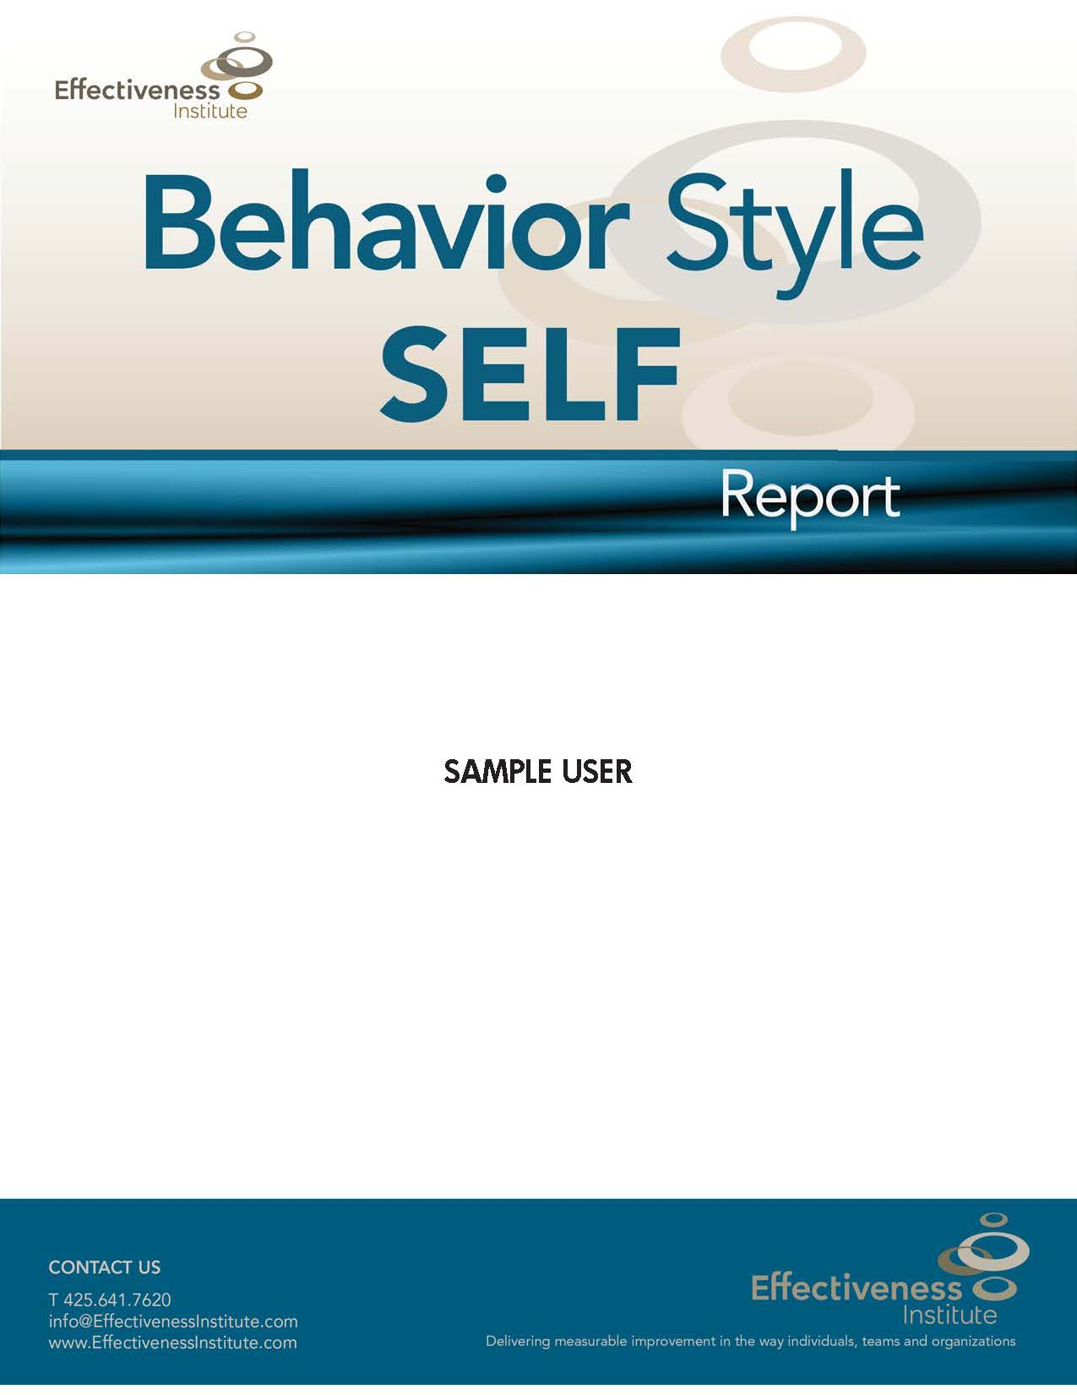
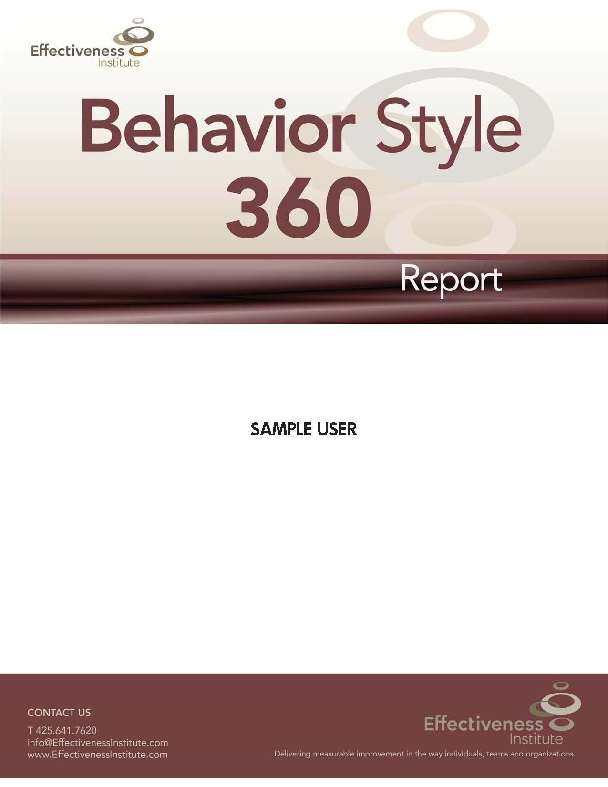

Slide 53
THANK YOU!
Lisa Bresnahan
lisa@effectivenessinstitute.com

